Slide 2
Fostering Learner Autonomy

Slide 3
Session plan
Learner Autonomy
Significance of LA
Six levels of LA
Suggestions

Slide 4
Learner Autonomy
Learner autonomy is when students take 1c…………… and 2r…………. for their own learning, both in terms of what they learn and 3h…………. they learn it. It takes as its starting point the idea that students are capable of 4self-d……….. and are able to develop an 5i……………….., proactive approach to their studies. It is important for the learners to become 6self-s……… language learners who can continue learning efficiently outside the classroom.
https://oupeltglobalblog.com/

Slide 5
Learner Autonomy
Learner autonomy is when students take control and responsibility for their own learning, both in terms of what they learn and how they learn it. It takes as its starting point the idea that students are capable of self-direction and are able to develop an independent, proactive approach to their studies. It is important for the learners to become self-sufficient language learners who can continue learning efficiently outside the classroom.
https://oupeltglobalblog.com/

Slide 6
Autonomous learners
Play an active role in their learning
Make decisions about their learning
Reflect on and evaluate their learning

Slide 7
Based on the definition of LA and the characteristics of autonomous learners, where do your students stand on average?

Slide 8
Classroom management models

Slide 9
Management Model: ?
Teacher
Students

Slide 10
Management Model: Hierarchical
Teacher
Students

Slide 11
Management Model: ?
Teacher
Students

Slide 12
Management Model: Cooperative
Teacher
Students

Slide 13
Management Model:?
Students
Teacher

Slide 14
Management Model: Autonomous
Students
Teacher

Slide 15
Which model is true of
most of your classes?

Slide 16
Why is la important?

Slide 17
Brings more student engagement, confidence, critical thinking, problem solving and accountability
Learning is more sustainable
There will be less labor and more facilitation for the teachers

Slide 18
Six levels of LA

Slide 19
6-Selves of autonomy
Self-direction
Self-assessment
Self-awareness
Self-monitoring
Self-reliance
Self-regulation

Slide 20
6-Selves of autonomy
Self-reliance
Self-awareness
Self-direction
Self-regulation
Self-monitoring
Self-assessment

Slide 21
6-Selves of autonomy
1. Self-reliance
Build independence

Slide 22
Shift of learning ownership

Slide 23
spoon feeding
Give a man a fish……………………………
Give a man a fish and you feed him for a day, ………

Slide 25
6-Selves of autonomy
2. Self-awareness
Strengths
Weaknesses

Slide 26
Learner Types
Visual
Auditory
Kinesthetic
Reading & Writing
Educationplanner.org

Slide 27
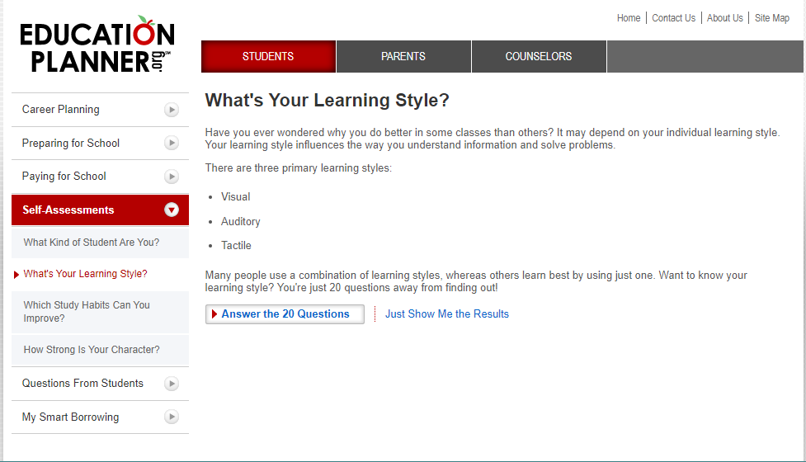

Slide 28
6-Selves of autonomy
3. Self-direction
Choices to follow

Slide 29
Students’ choice
Study skills
Skills prioritizing
Participation models

Slide 30
Projects & group work

Slide 31
6-Selves of autonomy
4. Self-regulation
Plan and control

Slide 32
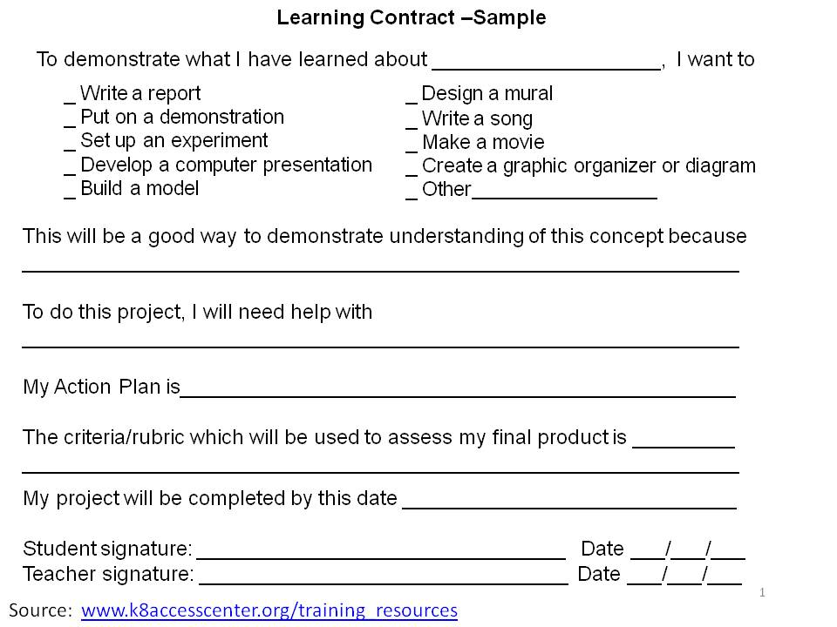
Goal setting and contract learning

Slide 33
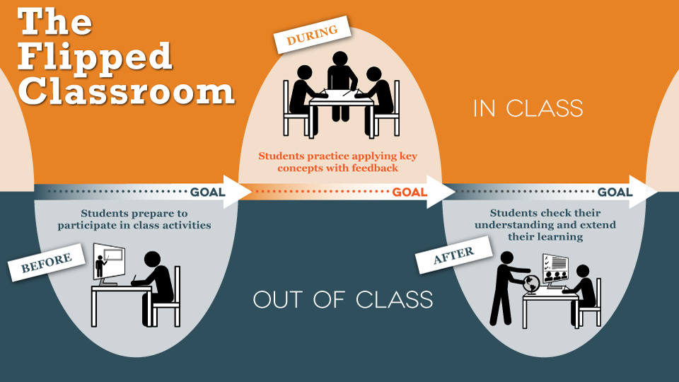

Slide 35
6-Selves of autonomy
5. Self-monitoring
Measuring progress

Slide 36
Weekly self assessment

Slide 37
6-Selves of autonomy
6. Self-assessment
locally and globally

Slide 38
ExamView Test Generator

Slide 39
True or false?
LA makes the teachers redundant.
LA is the same as self-instruction.
With LA, class control is somewhat lost.
TEACHERS create autonomy in students.
It only shifts our role to a facilitator.

Slide 40
Final words

Slide 41
Nurture the culture of LA
Go through the 6 levels of LA
Introduce contract learning
Don’t spoon feed or rush to answer questions (three before me rule)

Slide 42
Encourage them for mediation activities
Encourage them to keep a learner diary
Acknowledge their knowledge and they will embrace their learning

Slide 43
Thanks for participating!
amir@kardes.com.tr

